Slide 1
Arctic Vessel Monitoring Geofencing/Alert Awareness
Dr. Shawn Butler
University of Alaska Anchorage

Slide 2
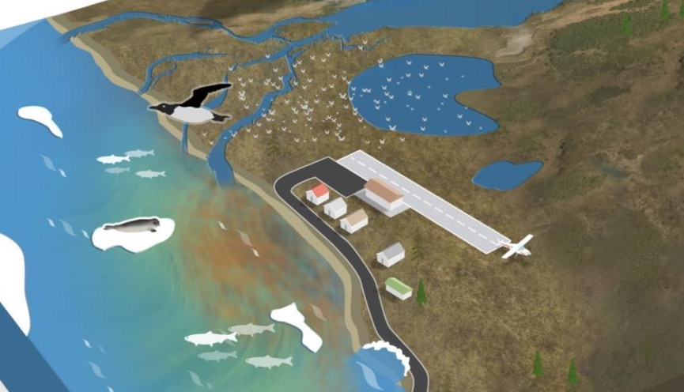
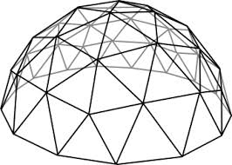
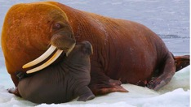
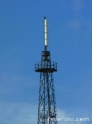
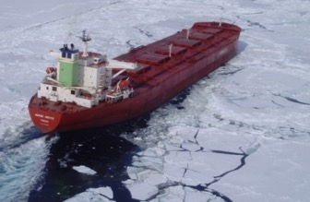
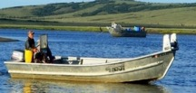
Project Goal
Advance US Coast Guard Arctic Maritime Domain Awareness & Management by capitalizing on the Alaska Marine Exchange’s PACTRACs geofencing capabilities using the Automatic Identification System (AIS) technology, providing geofencing management in CG OneView.
Marine Mammal Haulout
Subsistence Harvest

Slide 3
Project Team
Principal Investigators
  Dr. Shawn Butler, University of Alaska Anchorage
  Student Participation: Benjamin Good
  Axiom Data Science
  Project Champion: LT Evan Richter, USCG and Mr. James (Dan) Blackman

Slide 4
Project Baseline
Alaska Marine Exchange can create static and dynamic Geofences using the PACTRACS system for Marine Exchange members.
The 17th Coast Guard District can create static and dynamic Geofences using the AK Marine Exchange PACTRACS system
The vessel and interested subscribers are notified through text and email when the vessel crosses a geofence

Slide 5
Student Participation
Rachelle Lewis
  Identified the requirements for geofence management
  Implemented basic geofencing in CG One View using the Ozone Widget Framework (OWF)
  Rachelle Lewis completed her fellowship

Slide 6
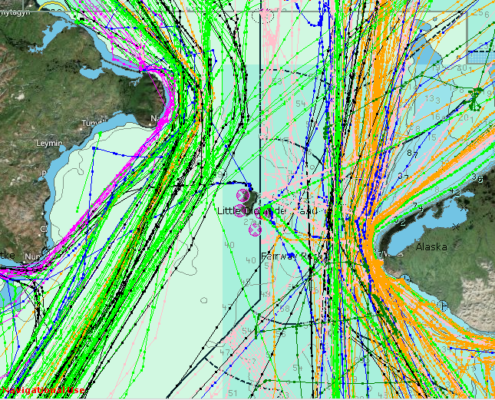
Project Objectives
CG OneView operators can create customized geofences / alerts.
CG Operators can manage existing geofences, i.e. find, edit, and delete geofences
Geofencing is seamlessly integrated into CG OneView.
Users can filter geofences to better discriminate vessel type and activities.
  Coast Guard, i.e. Anchorage Sector, requested even more filters
Geofences shared between CG One View and PacTracs

Slide 7
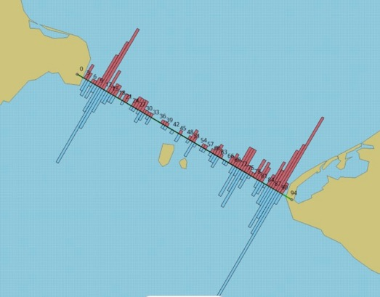
Challenges
  The development environment and CG OneView software developers kit is complex
  MISLE DB interaction is a strong requirement as is integrating VMS feed.
  Mr. Seraj Dhaliwal, one of our key technical links, moved to a different job so we will be working with someone new.
Russia
Alaska
Bering Strait Traffic 2017

Slide 8
Research Method
  Using agile-like software development methods, develop a geofencing prototype that can be transitioned into CG OneView
    Worked closely with the end users to develop requirements
    Worked closely with the end users during the development process to get feedback and refine requirements , adjusting the application as needed
    Worked closely with CG One View to review design decisions so that future integration issues are minimized
    Test and document the ability of 3rd party developers to add functionality into CG OneView

Slide 9
Project Phases
ADAC Quarterly Review – September 823, 2021
  Requirements and Analysis – Current Phase
    Identify user and non-functional requirements for geofencing capability – Completed
    Analyze existing system architectures to determine opportunities and gaps –Completed
  Design – Completed
    Develop a design that will support geofencing implementation and leverage existing Coast Guard or DHS capabilities -- Completed
    Established a technical exchange relationship with the technical lead for the front end. – Completed
  Implementation – In progress
    Axiom Data Science implemented some basic geofencing features
    Received stakeholder feedback
  Testing
    Integration testing with CG One View test environment – To be determined how well this will work, but feel strongly that it can be done quickly
    Documentation and making sure the code is resilient.

Slide 10
Milestone Completed – Operators are able to create, modify, and delete geofences.
ADAC Quarterly Review – September 23, 2021
If additional funds become available, we would add the ability to alert USCG operators based on Vessel Monitoring System (VMS) data and add the ability to add alerts using more refined filters.

Slide 11
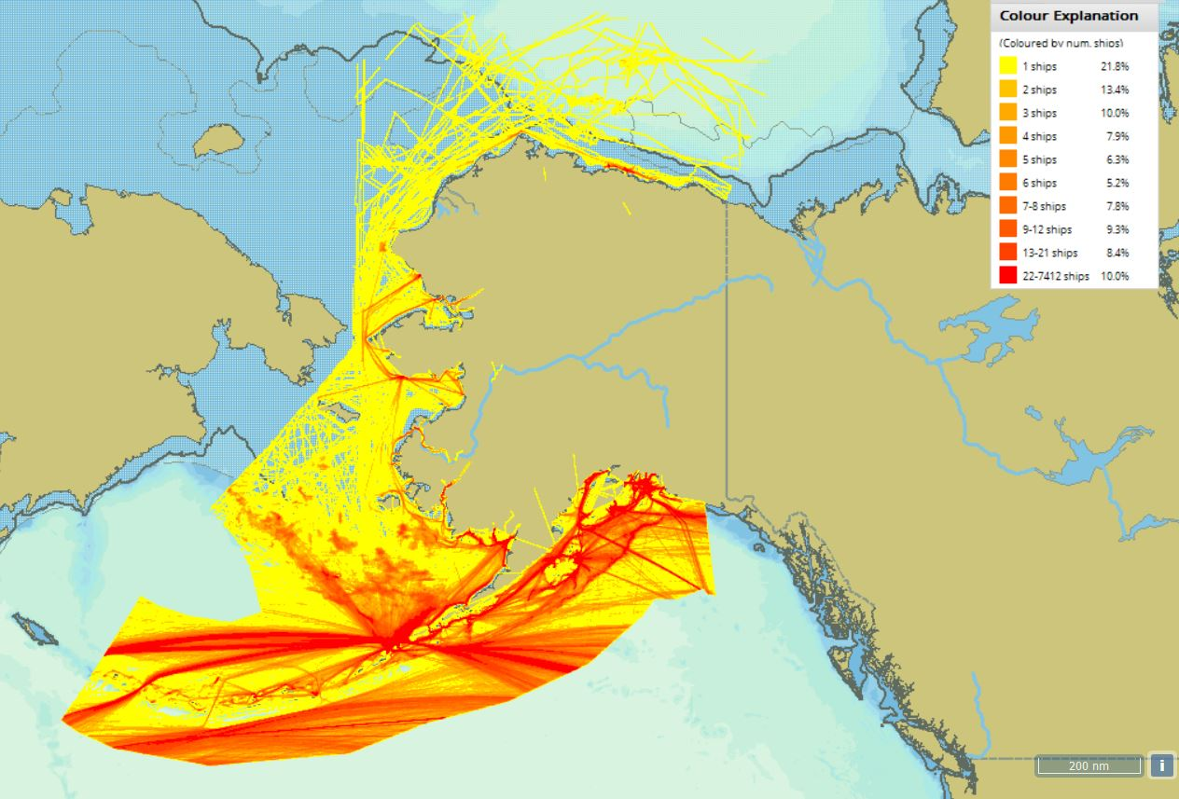
Questions and Comments
Arctic Vessel Monitoring Geofencing/Alert Awareness
Dr. Shawn Butler, University of Alaska Anchorage
Notes:
Thank you for the gift of your time and attention.

